Slide 1
Discipline in engineering
Marion Andrew Fondevilla
Aug 7, 2014
IED 2nd period

Slide 2
Agricultural engineering
What is agricultural engineering?
What does a agricultural engineer do?
How to become an agricultural engineer?
Three steps:
Degree
License
Certification

Slide 3
Areas of interest to Agricultural Engineers
Design of ag. machinery, equipment, and structures
Environmental control systems, cooling and ventilation
Energy Conservation
Crop production-seeding, tillage and irrigation practices
Soil & water conservation
Animal production and care
Biofuel production and utilization on the farm
Post harvest processing, handling and storage
Precision farming technologies, machine vision, GPS
Farm operations and management
Farm safety, security and ergonomics

Slide 4
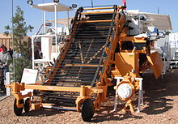
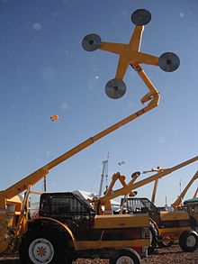
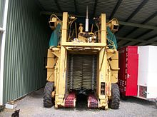
Machinery
Tomato Harvester
Tree Trimmer
Coffee bean Harvester

Slide 5
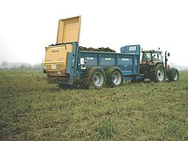
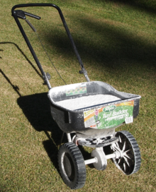
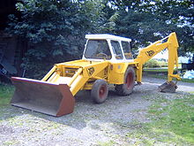
Machinery
Manure Spreader
Broadcast Seeder
Backhoe Loader

Slide 6
Thank you For listening guys!

